Slide 1

EN 14181 – QAL3
Standard deviation S_{AMS}
Guenter Haberzettl, ABB Analytical & Advanced Solutions, November 2013

Slide 2

QAL 3 – Demonstrate the required quality of an AMS
Standard deviation S_{AMS}
S_{AMS} value necessary for evaluation according CUSUM or Shewhart charts
Method 1
Using the Uncertainies Uc obtained during the suitability test
Additional performance data of the AMS for each of the influence factors
U_{inst} Is the uncertainty from stability
U_{temp} Is the uncertainty relating from variations in ambient temperature
U_{volt} Is the uncertainty relating from variations in voltage
U_{pre} Is the uncertainty relating from the variation of pressure
U_{others} Is any other uncertainy that may influence the reading on zero and reference material
Calculate
© ABB
11/08/26 AnalyzeIT Explorer | <number>

Slide 3
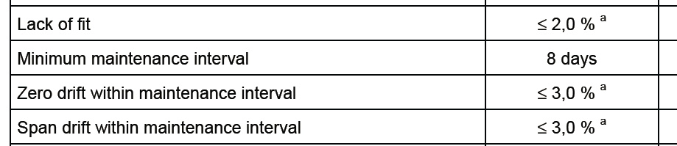
QAL 3 – Demonstrate the required quality of an AMS
Standard deviation S_{AMS}
Method 2
Following the performance criteria of the EN 15267-3
Extract of table 2
© ABB
11/08/26 AnalyzeIT Explorer | <number>

Slide 4
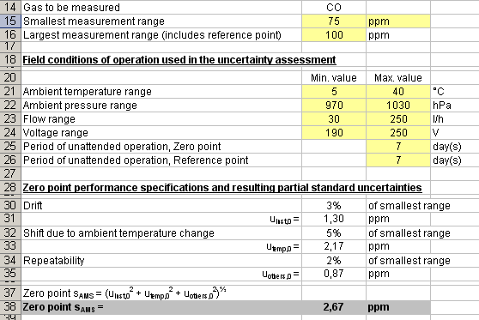
QAL 3 – Demonstrate the required quality of an AMS
Standard deviation S_{AMS} (Refer to the QAL3 tool)
(75 ppm x 3%)/ √3 = 1,30 ppm
Calculate
© ABB
11/08/26 AnalyzeIT Explorer | <number>

Slide 5
QAL 3 – Demonstrate the required quality of an AMS
Standard deviation S_{AMS}
Method 3
Accpeted by different compentent authorities in Europe
Practice according to the technical guidance VDI 3950
3% of the measuring range shall be used for control chart limits
© ABB
11/08/26 AnalyzeIT Explorer | <number>

